Slide 1
Theory and Algorithms for Formal Verification Computation Tree Logic, Mu-Calculus
Spring 2024: CSCI 699
Instructor: Jyo Deshmukh

Slide 2
Outline
CTL Syntax and Semantics
CTL Model Checking
CTL*
Basics of Lattice Theory and Fixpoint Computation
Mu-calculus
Tree Automata
Nondeterministic, Universal Tree Automata
Alternating Tree Automata

Slide 3
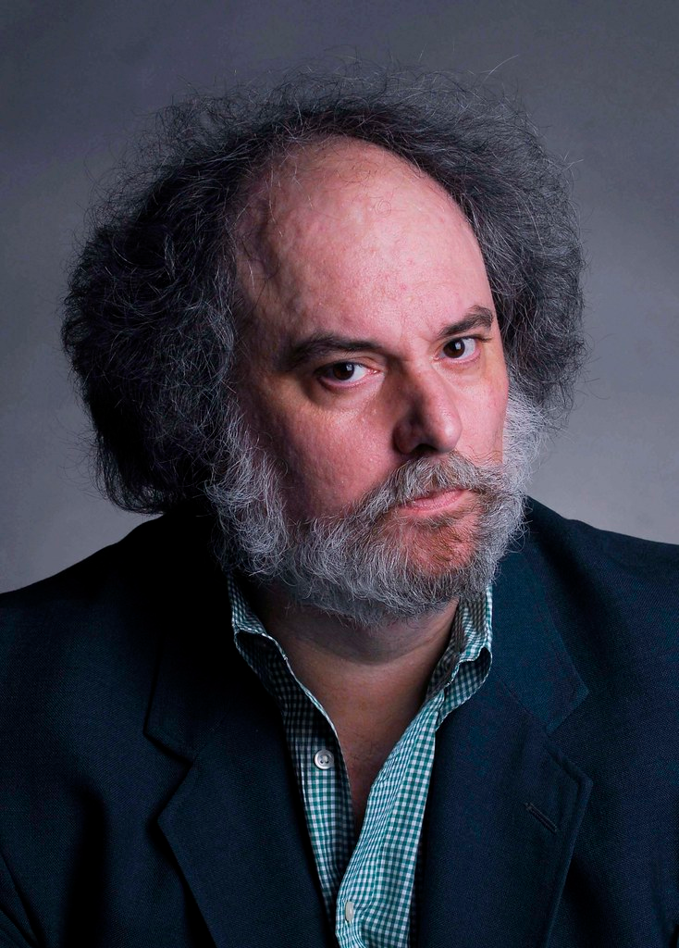
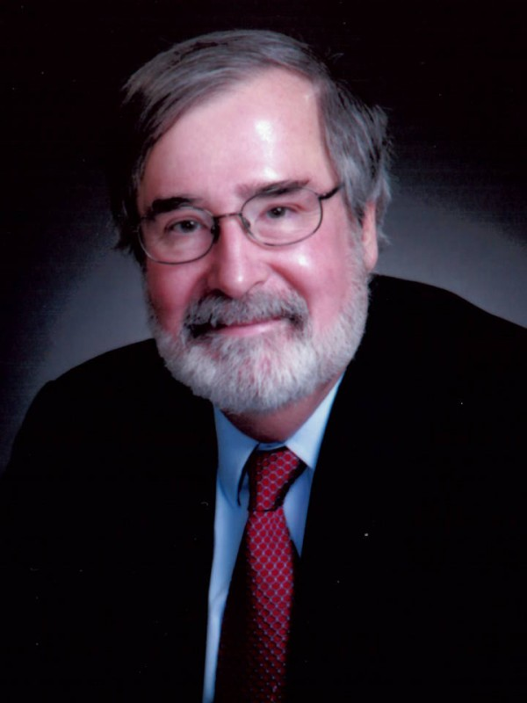
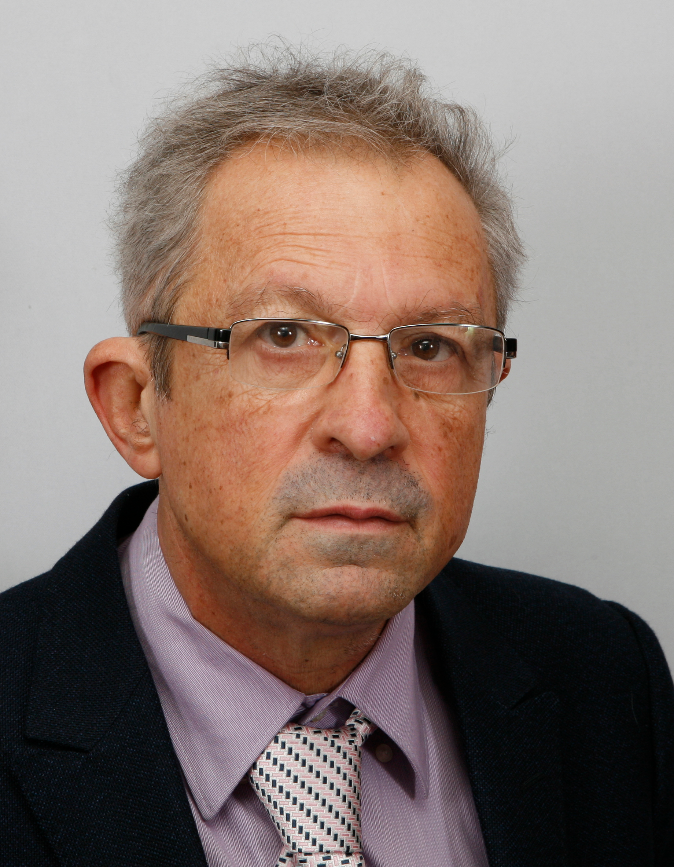
Computation Tree Logic
Model checking inventors,
ACM 2007 Turing Award winners
(L to R)
E. Allen Emerson
Ed Clarke
Josef Sifakis
Branching Time view of programs: we are interested not in a single timeline, but all possible timelines
Instead of program traces, we reason about computation trees
CTL is a logic defined over computation trees

Slide 4
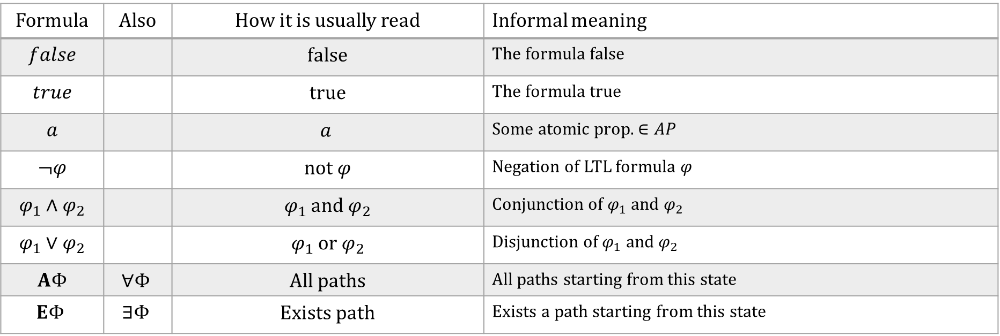
CTL syntax: state formulas $\left(φ\right)$
Formula | Also | How it is usually read | Informal meaning
$$false$$ |  | false | The formula false
$$true$$ |  | true | The formula true
$$a$$ |  | $$a$$ | Some atomic prop. $∈AP$
$$¬φ$$ |  | not $φ$ | Negation of LTL formula $φ$
$$φ_{1}∧φ_{2}$$ |  | $φ_{1}$ and $φ_{2}$ | Conjunction of $φ_{1}$ and $φ_{2}$
$$φ_{1}∨φ_{2}$$ |  | $φ_{1}$ or $φ_{2}$ | Disjunction of $φ_{1}$ and $φ_{2}$
$$AΦ$$ | $$∀Φ$$ | All paths | All paths starting from this state
$$EΦ$$ | $$∃Φ$$ | Exists path | Exists a path starting from this state
Important: $Φ$ is a path formula (defined on next slide)

Slide 5
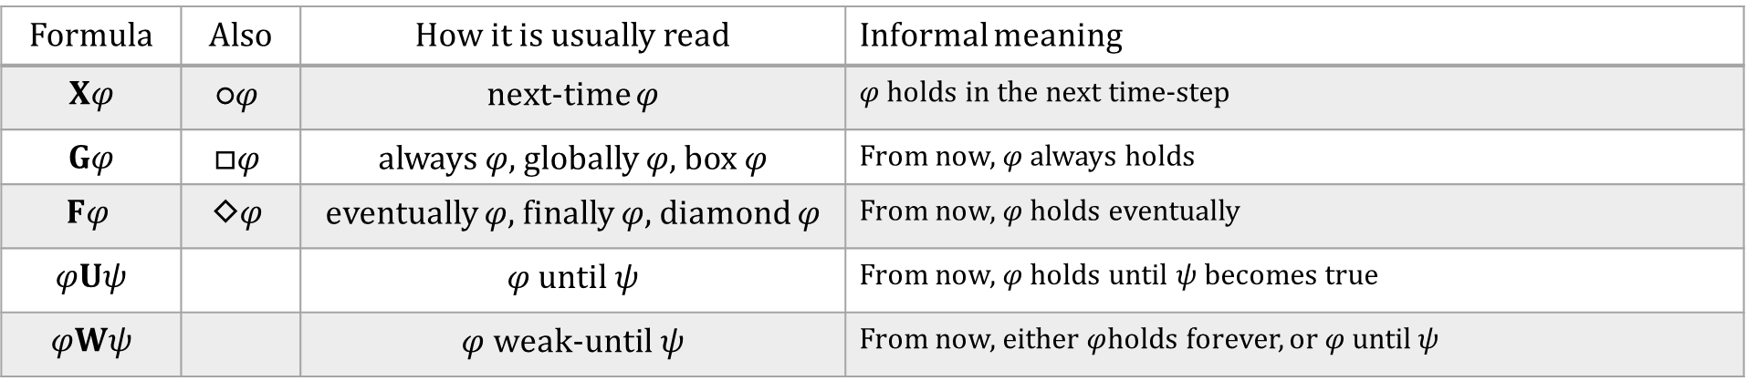
CTL syntax: path formulas $\left(Φ\right)$
Important: $φ, ψ$ are state formulas, not path formulas
Formula | Also | How it is usually read | Informal meaning
$$Xφ$$ | $$\text{○}φ$$ | next-time $φ$ | $φ$ holds in the next time-step
$$Gφ$$ | $$□φ$$ | always $φ,$globally $φ$, box $φ$ | From now, $φ$ always holds
$$Fφ$$ | $$\text{◇}φ$$ | eventually $φ$, finally $φ$, diamond $φ$ | From now, $φ$ holds eventually
$$φUψ$$ |  | $φ$ until$ψ$ | From now, $φ$ holds until $ψ$ becomes true
$$φWψ$$ |  | $φ$weak-until$ψ$ | From now, either $φ$holds forever, or $φ$ until$ψ$

Slide 6
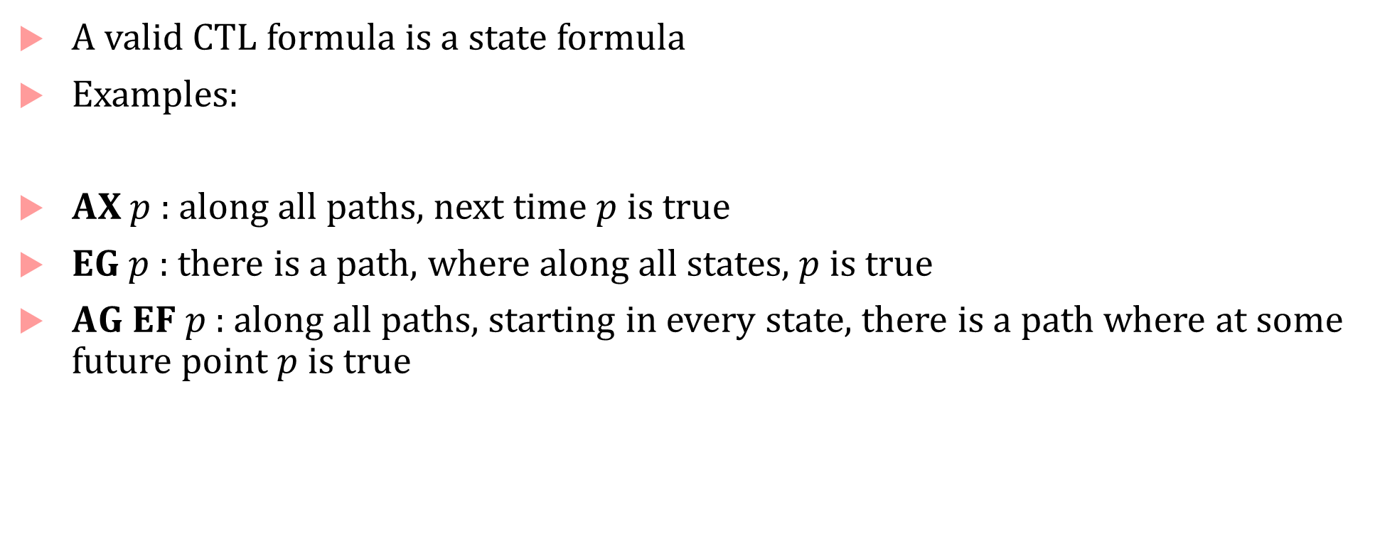
CTL Syntax
A valid CTL formula is a state formula
Examples:
$AX p$ : along all paths, next time $p$ is true
$EG p$ : there is a path, where along all states, $p$ is true
$AG EF p$ : along all paths, starting in every state, there is a path where at some future point $p$ is true

Slide 7


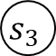
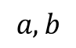
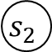

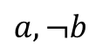
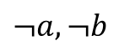
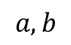
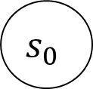
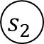
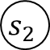
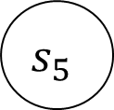
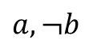


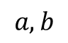
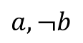
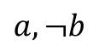
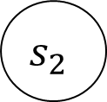

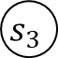
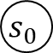

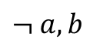
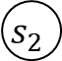

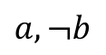
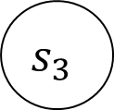
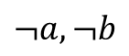

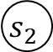


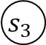
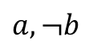
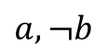





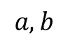
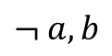

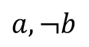
Infinite computation trees
CTL formulae are properties of trees or the computation tree representing states and paths of a transition system
Computation tree: infinite tree obtained by unrolling all possible transitions of an LTS
$$s_{0}$$
$$a,b$$
$$a,b$$
$$a,¬b$$
$$a,¬b$$
$$s_{1}$$
$$s_{2}$$
$$s_{0}$$
$$s_{2}$$
$$a,¬b$$
$$a,¬b$$
$$¬ a,b$$
$$a,b$$
$$s_{0}$$
$$s_{2}$$
$$s_{2}$$
$$s_{3}$$
$$a,¬b$$
$$a,¬b$$
$$a,¬b$$
$$s_{1}$$
$$s_{2}$$
$$s_{2}$$
$$s_{3}$$
$$s_{2}$$
$$s_{3}$$
$$s_{1}$$
$$s_{3}$$
$$s_{5}$$
$$s_{1}$$
$$s_{3}$$
$$¬a,¬b$$
$$a,b$$
$$¬a,¬b$$
$$s_{0}$$
$$s_{2}$$
$$s_{2}$$
$$s_{3}$$
$$s_{2}$$
$$s_{3}$$
$$s_{1}$$
$$s_{3}$$
$$s_{5}$$
$$a,¬b$$
$$¬ a,b$$
$$s_{5}$$

Slide 8
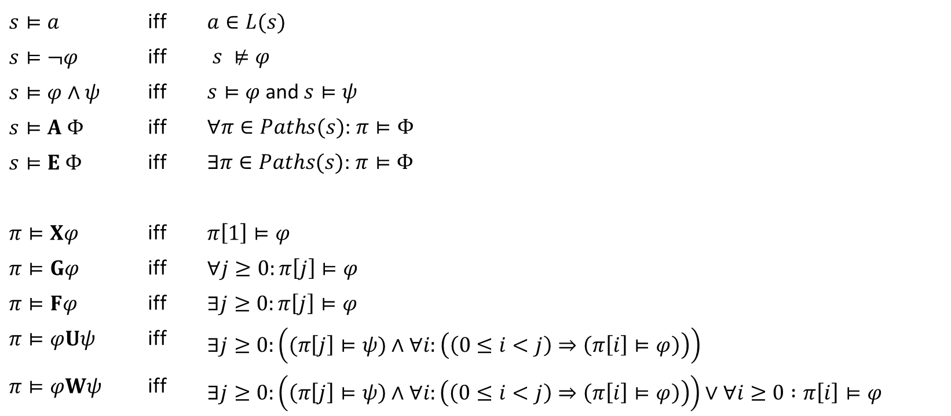
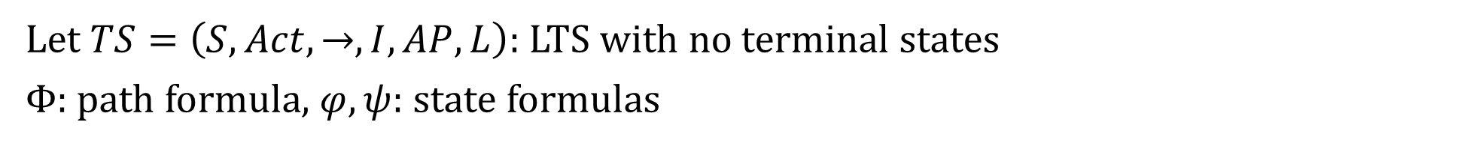
Satisfaction relation for CTL
Let $TS=\left(S,Act,→, I,AP,L\right)$: LTS with no terminal states
$Φ$: path formula, $φ,ψ$: state formulas
$$s⊨a$$ | iff | $$a∈L(s)$$
$$s⊨¬φ$$ | iff | $s ⊭φ$
$$s⊨φ∧ψ$$ | iff | $s⊨φ$ and $s⊨ψ$
$$s⊨A Φ$$ | iff | $∀π∈Paths(s)$: $π⊨Φ$
$$s⊨E Φ$$ | iff | $∃π∈Paths(s)$: $π⊨Φ$
$$π⊨Xφ$$ | iff | $$π\left[1\right]⊨φ$$
$$π⊨Gφ$$ | iff | $$∀j≥0:π\left[j\right]⊨φ$$
$$π⊨Fφ$$ | iff | $$∃j≥0:π\left[j\right]⊨φ$$
$$π⊨φUψ$$ | iff | $$∃j≥0:\left((π\left[j\right]⊨ψ)∧∀i:\left(\left(0≤i<j\right)⇒\left(π\left[i\right]⊨φ\right)\right)\right)$$
$$π⊨φWψ$$ | iff | $∃j≥0:\left(\left(π\left[j\right]⊨ψ\right)∧∀i:\left(\left(0≤i<j\right)⇒\left(π\left[i\right]⊨φ\right)\right)\right)∨∀i≥0 :π\left[i\right]⊨φ$

Slide 9
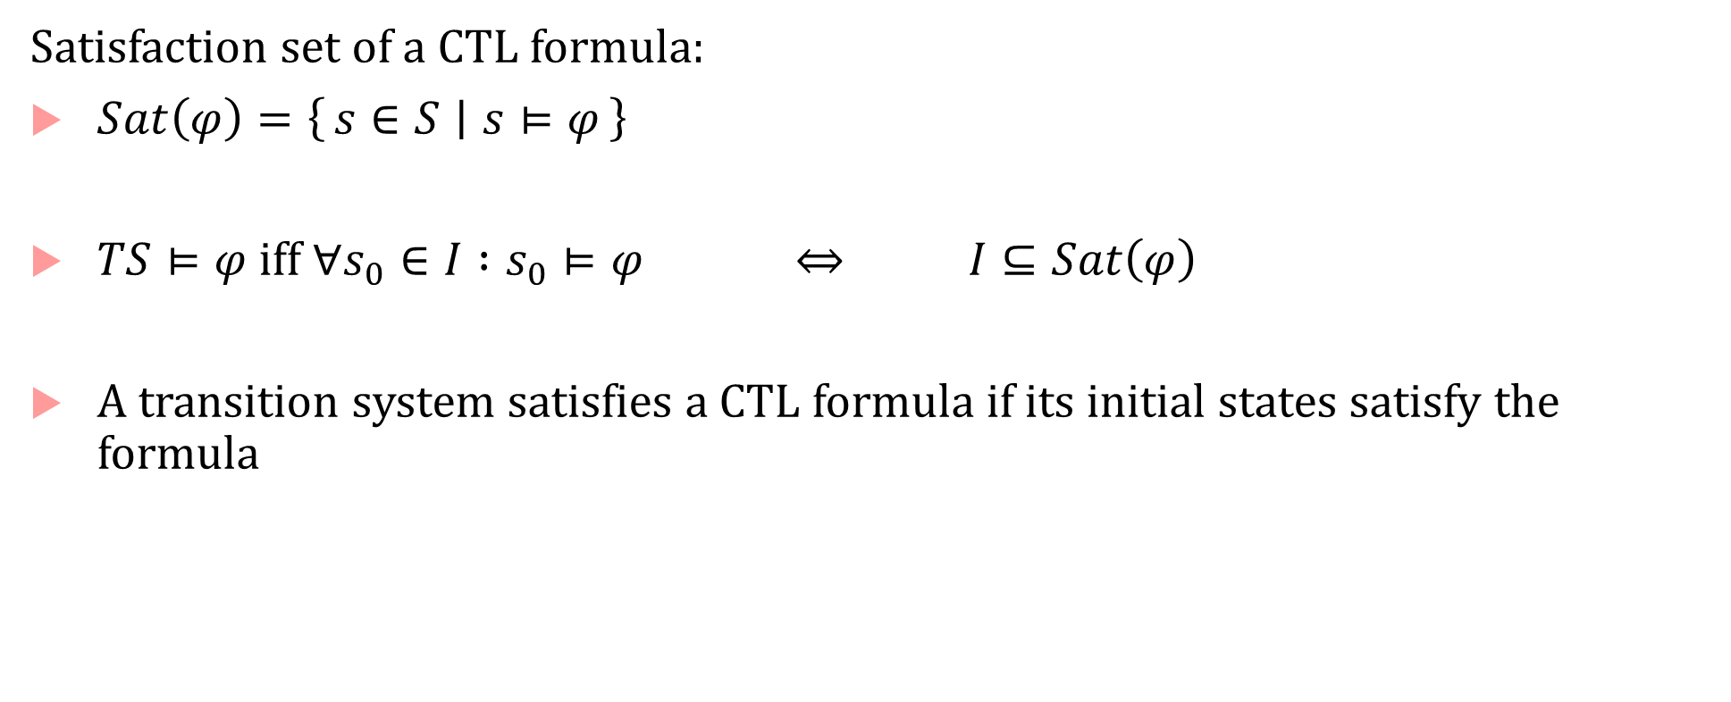
CTL semantics for LTS
Satisfaction set of a CTL formula:
$Sat\left(φ\right)=\left\{s∈S ∣ s⊨φ\right\}$
$TS⊨φ$ iff $∀s_{0}∈I :s_{0}⊨φ$ $⇔$ $I⊆Sat\left(φ\right)$
A transition system satisfies a CTL formula if its initial states satisfy the formula

Slide 10
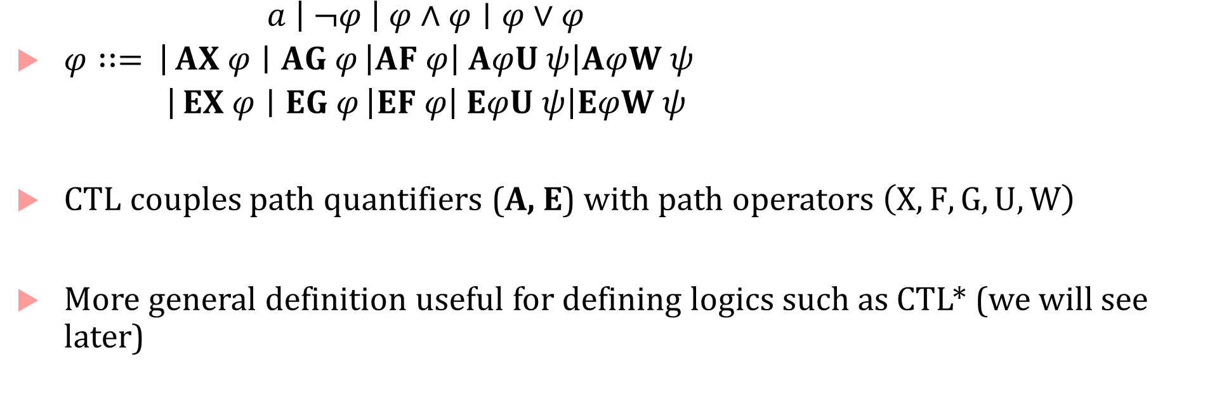
Simpler way of thinking about CTL
$φ∷=$ $\begin{matrix}\begin{aligned}a \left| ¬φ \right| φ∧φ∣φ∨φ \\ \left|AX φ ∣ AG φ\right|AF φ\left| AφU ψ\right|AφW ψ\end{aligned} \\ \left|EX φ ∣ EG φ\right|EF φ\left| EφU ψ\right|EφW ψ\end{matrix}$
CTL couples path quantifiers (A, E) with path operators $\left(X,F,G,U,W\right)$
More general definition useful for defining logics such as CTL* (we will see later)

Slide 11
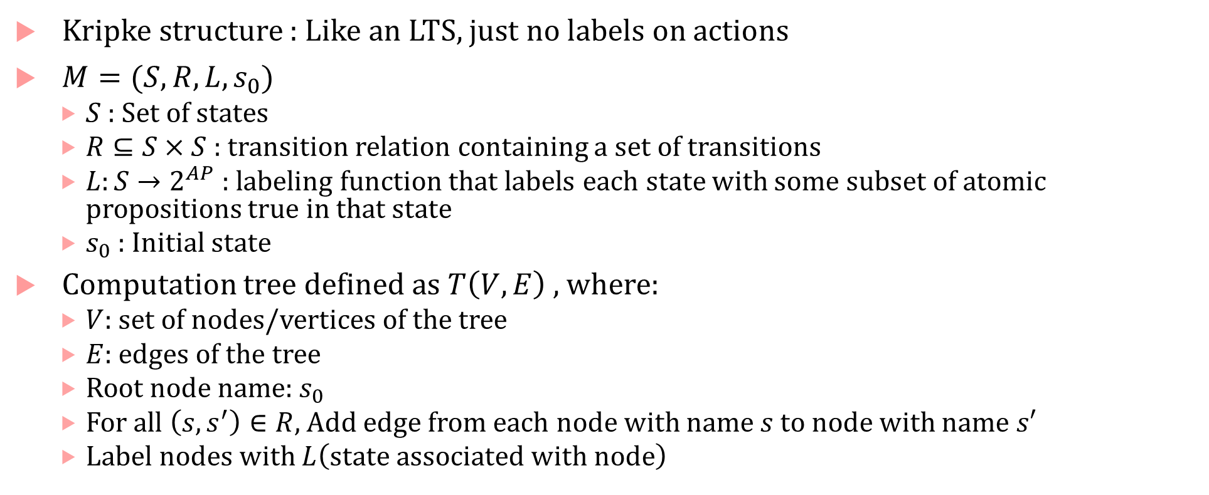
Kripke structure
Kripke structure : Like an LTS, just no labels on actions
$M=(S,R,L,s_{0})$
$S$ : Set of states
$R⊆S×S$: transition relation containing a set of transitions
$L:S→2^{AP}$ : labeling function that labels each state with some subset of atomic propositions true in that state
$s_{0}$ : Initial state
Computation tree defined as $T\left(V,E\right)$ , where:
$V:$ set of nodes/vertices of the tree
$E$: edges of the tree
Root node name: $s_{0}$
For all $\left(s,s^{′}\right)∈R$, Add edge from each node with name $s$ to node with name $s′$
Label nodes with $L\left(state associated with node\right)$

Slide 12

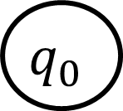
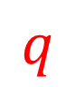


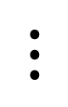
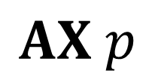
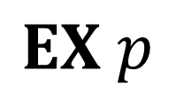



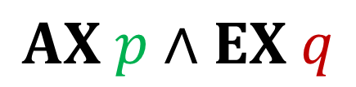







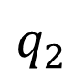

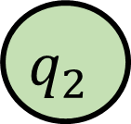




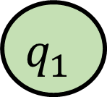



CTL Semantics examples
$$q_{0}$$
$$q_{0}$$
$$q_{0}$$
$$p$$
$$p$$
$$q_{1}$$
$$p$$
$$q_{2}$$
$$q_{1}$$
$$q_{2}$$
$$p$$
$$q_{1}$$
$$p$$
$$q_{2}$$
$$q$$
$$⋮$$
$$⋮$$
$$⋮$$
$$⋮$$
$$⋮$$
$$⋮$$
$$⋮$$
$$⋮$$
$$⋮$$
$$⋮$$
$$⋮$$
$$⋮$$
$$AX p$$
$$EX p$$
$$AX p∧EX q$$

Slide 13



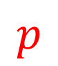










CTL Semantics examples
$$q_{0}$$
$AF p$: Along all
Paths, There is some future step where $p$ holds
$$q_{0}$$
$$p$$
$EF p$: Along some
path, there is some future step where $p$ holds
$$p$$
$$p$$
$$p$$
$$p$$
$$p$$
(Irrelevant)
$$⋮$$
$$⋮$$
$$⋮$$
$$⋮$$

Slide 14




















CTL semantics examples
$AG p$: Across all
paths, and for every successor in the path, $p$ holds
$$q_{0}$$
$$p$$
$$q_{0}$$
$$p$$
$$p$$
$$p$$
$$p$$
$$p$$
$$p$$
$$⋮$$
$EG p$: Along some
path, $p$ always holds
$$p$$
$$⋮$$
$$⋮$$
$$p$$
$$p$$
$$⋮$$
$$⋮$$
$$⋮$$
$$⋮$$
$$⋮$$

Slide 15








CTL semantics
$$s_{0}$$
$$s_{2}$$
$AG EF p$
$$s_{6}$$
$$s_{1}$$
$$s_{3}$$
$$s_{5}$$
$$p$$

Slide 16

CTL satisfaction by a LTS
$$s_{0}$$
$$s_{2}$$
Does LTS satisfy $AG AF p$?
$$s_{6}$$
$$s_{1}$$
$$s_{3}$$
$$s_{5}$$
$$p$$

Slide 17















CTL satisfaction by a LTS
Does LTS satisfy $AG AF p$?
No!
$$s_{0}$$
$$s_{0}$$
$$s_{2}$$
$$s_{2}$$
States along this path do not satisfy $AF p$
$$s_{3}$$
$$s_{1}$$
$$s_{5}$$
$$s_{6}$$
$$s_{5}$$
$$s_{6}$$
$$s_{5}$$
$$s_{0}$$
$$s_{6}$$
States along these paths satisfy $AF p$
$$s_{1}$$
$$s_{3}$$
$$s_{2}$$
$$s_{3}$$
$$s_{1}$$
$$s_{5}$$
$$s_{6}$$
$$s_{5}$$
$$s_{6}$$
$$s_{5}$$
$$s_{5}$$
$$s_{0}$$
$$p$$

Slide 18

CTL equivalences
Duality:
$$¬AX φ≡EX¬φ \\ ¬AF φ≡EG ¬φ$$
$$¬AG φ≡EF ¬φ$$
$$¬AφUψ≡E \left(φ∧¬ψ\right)W\left(¬φ∧¬ψ\right)$$
Distributivity:
$$AG\left(φ∧ψ\right)=AGφ∧AGψ$$
$$EF\left(φ∨ψ\right)=EFφ∨EFψ$$

Slide 19



More relations
Does: $AFφ∨AFψ⇒ AF\left(φ∨ψ\right) ?$
Yes
Does $AF\left(φ∨ψ\right)⇒AFφ∨AFψ$?
No!
$AFφ∨AFψ ≢ AF\left(φ∨ψ\right)$
Similarly, $EGφ∧EGψ ≢EG\left(φ∧ψ\right)$

Slide 20



Expressiveness: CTL vs. LTL
Logics have the same expressive power if there is no LTS that satisfies formulas from one logic but not from the other (and vice versa)
LTL formulas implicitly mean “for all paths”
Maybe convert from CTL means remove all universal path quantifiers?
Are CTL formulas $AFAGa$ and LTL formula $FGa$ equivalent?
$TS\underset{⊨}{?}FGa$
Yes!
$TS\underset{⊨}{?}AFAGa$
No!

Slide 21



Expressiveness CTL vs. LTL
Similarly, $AF\left(a∧AX a\right)$ is not equivalent to $F(a∧Xa)$
$TS\underset{⊨}{?}F(a∧Xa)$
Yes!
$TS\underset{⊨}{?}AF(a∧AXa)$
No!

Slide 22





Expressiveness CTL vs. LTL
Proof of why LTL cannot express $AGEFa$
$${TS}_{1}$$
$${TS}_{2}$$
Clearly, $TS_{1}⊨AGEFa$
Suppose there exists an LTL formula $φ$ that accepts only those traces that satisfy $AGEFa$, so, $Traces\left(TS_{1}\right)⊆ℒ_{ω}\left(φ\right)$
But $Traces\left(TS_{2}\right)⊂Traces\left(TS_{1}\right)$, so $Traces\left(TS_{2}\right)⊆ℒ_{ω}\left(φ\right)$, i.e., $TS_{2}⊨φ$
But $TS_{2}⊭AGEFa$, which is a contradiction.

Slide 23


Expressiveness: CTL vs. LTL
$∀n≥0$:
${TS}_{n}^{′}⊨FGp$, but
${TS}_{n}⊭FGp$
But, there is no CTL formula of length $n$ that can distinguish the two transition systems!
Proof by induction

Slide 24
CTL vs. LTL expressiveness
The expressive power of CTL and LTL is incomparable
Logic CTL* subsumes both kinds of logic
There is a logic in the intersection of CTL and LTLª
a. Monika Maidl, The Common Fragment of CTL and LTL, FoCS 2000.

Slide 25

CTL model checking
Given $TS$ and CTL formula $φ$ check if $TS⊨φ$
Basic idea: backward computation
Set of states satisfying $φ$: $Sat\left(φ\right)$ is computed recursively
$TS⊨φ$ iff $I⊆Sat\left(φ\right)$

Slide 26

$$Sat(φ)$$
$$φ≡$$
$$φ_{1}∧φ_{2}$$ | return $Sat\left(φ_{1}\right)∩Sat\left(φ_{2}\right)$
$$φ_{1}∨φ_{2}$$ | return $Sat\left(φ_{1}\right)∪Sat \left(φ_{2}\right)$
$$¬φ$$ | return $S∖Sat\left(φ\right)$
$$EXφ$$ | return { $s∈S∣Post\left(s\right)∩Sat \left(φ\right)≠∅$ }
$$AXφ$$ | return { $s∈S∣Post\left(s\right)⊆Sat \left(φ\right)$}
$$EFφ$$ | return lfp of $Y=φ∨EX Y$
$$AFφ$$ | return lfp of $Y=φ∨AX Y$
$$EGφ$$ | return gfp of $Z=φ∧EX Z$
$$AGφ$$ | return gfp of $Z=φ∧AX Z$
$$EφUψ$$ | return lfp of $Y=ψ∨(φ∧EX Y)$
$$AφUψ$$ | return gfp of $Y=ψ∨(φ∧AX Y)$
$$EφWψ$$ | return gfp of $Y=ψ∨(φ∧EX Y)$
$$AφWψ$$ | return gfp of $Y=ψ∨(φ∧AX Y)$

Slide 27

Least Fix-points
ComputeLFP $(Y=φ∨EX Y)$
$$Y_{0}=Sat\left(φ\right)$$
$$n=1$$
while $(Y_{n−1}≠Y_{n})$
$Y_{n}≔Y_{n−1 }∪\left\{ s ∣ Post\left(s\right)∩Y_{n−1}≠∅\right\}$
$n≔n+1$
end

Slide 28










EF green
$$Y_{0}=Sat\left(φ\right)$$
$$n=1$$
while $(Y_{n−1}≠Y_{n})$
$Y_{n}≔Y_{n−1 }∪\left\{ s ∣ Post\left(s\right)∩Y_{n−1}≠∅\right\}$
$n≔n+1$
end
$$s_{0}$$
$$s_{1}$$
$$s_{2}$$
$$s_{5}$$
$$s_{6}$$
$$Y_{0}=\{s_{4}\}$$
$$s_{3}$$
$$s_{4}$$
$$green$$

Slide 29


EF green
$$Y_{0}=Sat\left(φ\right)$$
$$n=1$$
while $(Y_{n−1}≠Y_{n})$
$Y_{n}≔Y_{n−1 }∪\left\{ s ∣ Post\left(s\right)∩Y_{n−1}≠∅\right\}$
$n≔n+1$
end
$$s_{0}$$
$$s_{1}$$
$$s_{2}$$
$$s_{5}$$
$$s_{6}$$
$$Y_{0}=\{s_{4}\}$$
$$Y_{1}=\left\{s_{4},s_{3}\right\}$$
$$s_{3}$$
$$s_{4}$$
$$green$$

Slide 30


EF green
$$Y_{0}=Sat\left(φ\right)$$
$$n=1$$
while $(Y_{n−1}≠Y_{n})$
$Y_{n}≔Y_{n−1 }∪\left\{ s ∣ Post\left(s\right)∩Y_{n−1}≠∅\right\}$
$n≔n+1$
end
$$s_{0}$$
$$s_{1}$$
$$s_{2}$$
$$s_{5}$$
$$s_{6}$$
$$Y_{0}=\{s_{4}\}$$
$$Y_{1}=\left\{s_{4},s_{3}\right\}$$
$$Y_{2}=\{s_{4},s_{3},s_{1}\}$$
$$s_{3}$$
$$s_{4}$$
$$green$$

Slide 31


EF green
$$Y_{0}=Sat\left(φ\right)$$
$$n=1$$
while $(Y_{n−1}≠Y_{n})$
$Y_{n}≔Y_{n−1 }∪\left\{ s ∣ Post\left(s\right)∩Y_{n−1}≠∅\right\}$
$n≔n+1$
end
$$s_{0}$$
$$s_{1}$$
$$s_{2}$$
$$s_{5}$$
$$s_{6}$$
$$Y_{0}=\{s_{4}\}$$
$$Y_{1}=\left\{s_{4},s_{3}\right\}$$
$$Y_{2}=\{s_{4},s_{3},s_{1}\}$$
$$Y_{3}=\{s_{4},s_{3},s_{1}, s_{0}\}$$
$$s_{3}$$
$$s_{4}$$
$$green$$

Slide 32


EF green
$$Y_{0}=Sat\left(φ\right)$$
$$n=1$$
while $(Y_{n−1}≠Y_{n})$
$Y_{n}≔Y_{n−1 }∪\left\{ s ∣ Post\left(s\right)∩Y_{n−1}≠∅\right\}$
$n≔n+1$
end
$$s_{0}$$
$$s_{1}$$
$$s_{2}$$
$$s_{5}$$
$$s_{6}$$
$$Y_{0}=\{s_{4}\}$$
$$Y_{1}=\left\{s_{4},s_{3}\right\}$$
$$Y_{2}=\{s_{4},s_{3},s_{1}\}$$
$$Y_{3}=\{s_{4},s_{3},s_{1}, s_{0}\}$$
$$Y_{4}=\{s_{4},s_{3},s_{1}, s_{0},s_{2}\}$$
$$s_{3}$$
$$s_{4}$$
$$green$$

Slide 33

EF green
$$Y_{0}=Sat\left(φ\right)$$
$$n=1$$
while $(Y_{n−1}≠Y_{n})$
$Y_{n}≔Y_{n−1 }∪\left\{ s ∣ Post\left(s\right)∩Y_{n−1}≠∅\right\}$
$n≔n+1$
end
$$s_{0}$$
$$s_{1}$$
$$s_{2}$$
$$s_{5}$$
$$s_{6}$$
$$Y_{0}=\{s_{4}\}$$
$$Y_{1}=\left\{s_{4},s_{3}\right\}$$
$$Y_{2}=\{s_{4},s_{3},s_{1}\}$$
$$Y_{3}=\{s_{4},s_{3},s_{1}, s_{0}\}$$
$$Y_{4}=\{s_{4},s_{3},s_{1}, s_{0},s_{2}\}$$
$$Y_{5}=\left\{s_{4},s_{3},s_{1}, s_{0},s_{2}\right\}$$
$Y_{4}=Y_{5}$!
$s_{0}∈Sat(EF green)$, so $TS⊨EF green$
$$s_{3}$$
$$s_{4}$$
$$green$$

Slide 34

Backward enumeration
How do you compute: $\left\{ s ∣ Post\left(s\right)∩Y_{n−1}≠∅\right\}$?
$$T=∅$$
forall $s^{′}∈Y_{n−1}$
forall $s∈Pre\left(s^{′}\right)$
$T≔ T∪\{s\}$
end
end

Slide 35

Backward enumeration for $lfp (Y=φ∨AX Y)$
How do you compute: $\left\{ s ∣ Post\left(s\right)⊆Y_{n−1}\right\}$?
$$T=∅$$
forall $s^{′}∈Y_{n−1}$
forall $s∈Pre\left(s^{′}\right)$
if ($Post\left(s\right)⊆Y_{n−1}$)
$T≔ T∪\{s\}$
endif
end
end

Slide 36

Greatest Fix-points
ComputeGFP $(Z=φ∧EX Z)$
$$Z_{0}=Sat\left(φ\right)$$
$$n=1$$
while $(Z_{n−1}≠Z_{n})$
$Z_{n}≔Z_{n−1 }∩\left\{ s∈Sat\left(φ\right) ∣ Post\left(s\right)∩Z_{n−1}≠∅\right\}$
$n≔n+1$
end

Slide 37








EG green
$$Z_{0}=Sat\left(φ\right)$$
$$n=1$$
while $(Z_{n−1}≠Z_{n})$
$Z_{n}≔Z_{n−1 }∩\left\{ s∈Sat\left(φ\right) ∣ Post\left(s\right)∩Z_{n−1}≠∅\right\}$
$n≔n+1$
end
$$s_{0}$$
$$Z_{0}=\{s_{0},s_{1},s_{2},s_{4},s_{5}\}$$
$$s_{1}$$
$$s_{3}$$
$$s_{5}$$
$$s_{6}$$
$$s_{2}$$
$$s_{4}$$

Slide 38



EG green
$$Z_{0}=Sat\left(φ\right)$$
$$n=1$$
while $(Z_{n−1}≠Z_{n})$
$Z_{n}≔Z_{n−1 }∩\left\{ s∈Sat\left(φ\right) ∣ Post\left(s\right)∩Z_{n−1}≠∅\right\}$
$n≔n+1$
end
$$s_{0}$$
$$Z_{0}=\{s_{0},s_{1},s_{2},s_{4},s_{5}\}$$
$$Z_{1}=Z_{0}∩\left\{s_{0},s_{1},s_{2}\right\}=\{s_{0},s_{1},s_{2}\}$$
$$s_{1}$$
$$s_{3}$$
$$s_{5}$$
$$s_{6}$$
$$s_{2}$$
$$s_{4}$$

Slide 39

EG green
$$Z_{0}=Sat\left(φ\right)$$
$$n=1$$
while $(Z_{n−1}≠Z_{n})$
$Z_{n}≔Z_{n−1 }∩\left\{ s∈Sat\left(φ\right) ∣ Post\left(s\right)∩Z_{n−1}≠∅\right\}$
$n≔n+1$
end
$$s_{0}$$
$$Z_{0}=\{s_{0},s_{1},s_{2},s_{4},s_{5}\}$$
$$Z_{1}=Z_{0}∩\left\{s_{0},s_{1},s_{2}\right\}=\left\{s_{0},s_{1},s_{2}\right\}$$
$$Z_{2}=Z_{1}∩\left\{s_{0},s_{1},s_{2}\right\}=\left\{s_{0},s_{1},s_{2}\right\}$$
$$Z_{2}=Z_{1}!$$
$s_{0}∈Sat(EG green)$, so $TS⊨EF green$
$$s_{1}$$
$$s_{3}$$
$$s_{5}$$
$$s_{6}$$
$$s_{2}$$
$$s_{4}$$

Slide 40

Time complexity
Time complexity: $O\left(\left(\left|S\right|+|→|\right)\left|φ\right|\right)$
Linear in the size of the LTS states and transitions
Linear in the size of the formula
Note that LTL is exponential in the size of the formula, but CTL formulas are provably longer than LTL formulas

Slide 41

CTL* state formula
Formula | Also | How it is usually read | Informal meaning
$$false$$ |  | false | The formula false
$$true$$ |  | true | The formula true
$$a$$ |  | $$a$$ | Some atomic prop. $∈AP$
$$¬Φ$$ |  | not $φ$ | Negation of LTL formula $φ$
$$φ_{1}∧φ_{2}$$ |  | $φ_{1}$ and $φ_{2}$ | Conjunction of $φ_{1}$ and $φ_{2}$
$$φ_{1}∨φ_{2}$$ |  | $φ_{1}$ or $φ_{2}$ | Disjunction of $φ_{1}$ and $φ_{2}$
$$AΦ$$ | $$∀Φ$$ | All paths | All paths starting from this state
$$EΦ$$ | $$∃Φ$$ | Exists path | Exists a path starting from this state

Slide 42

CTL* path formula
Formula | Also | How it is usually read | Informal meaning
$$φ$$
$$φ_{1}∧φ_{2}$$
$$¬φ$$
$$Xφ$$ | $$\text{○}φ$$ | next-time $φ$ | $φ$ holds in the next time-step
$$Gφ$$ | $$□φ$$ | always $φ,$globally $φ$, box $φ$ | From now, $φ$ always holds
$$Fφ$$ | $$\text{◇}φ$$ | eventually $φ$, finally $φ$, diamond $φ$ | From now, $φ$ holds eventually
$$φUψ$$ |  | $φ$ until$ψ$ | From now, $φ$ holds until $ψ$ becomes true
$$φWψ$$ |  | $φ$weak-until$ψ$ | From now, either $φ$holds forever, or $φ$ until$ψ$

Slide 43

CTL*
You do not need to “couple” a path quantifier and a temporal operator!
Examples of CTL* formulas:
$AG\left(XF a∧¬\left(b U Gc\right)\right)$
$AXG¬a$

Slide 44

CTL* is more expressive than LTL or CTL
$φ≡AFGa∨AGEF b$
There is no equivalent LTL or CTL formula
Simple proof: the first cannot be expressed in CTL, the second cannot be expressed in LTL ☺

Slide 45

CTL* model checking
Main idea: use CTL-style backward model checking algorithm
Replace maximal proper state sub-formulae by fresh atomic propositions
E.g.: $E\left(X\left(AGEFa\right)∧FGE\left(Xa∧Gb\right)\right)$
Maximal proper state subformuale : $AGEF a$, $E\left(Xa∧Gb\right)$
So, we are now model checking: $E\left(X\left(a_{1}\right)∧FG\left(a_{2}\right)\right)$
To model check $s⊨Eφ$, we need to check if $s⊭A¬φ$, which we can check using an LTL model checker!

Slide 46

CTL* model checking time complexity
$O\left(\left(\left|S\right|+|→\right|)2^{\left|φ\right|}\right)$
Linear in the size of the LTS
Exponential in the size of the formula

Slide 47

Mu calculus
Syntax:
Atomic proposition constants $∈AP$
Atomic proposition variables $Y,Z,$
$EX φ$
$¬φ$
$φ_{1}∧φ_{2}$
$μY. φ\left(Y\right)$ where $φ\left(Y\right)$ is any formula syntactically monotone in the propositional variable $Y$
Syntactically monotone: All occurrences of $Y$ in $φ\left(Y\right)$ fall under an even number of negations

Slide 48

Mu calculus
$μY. φ\left(Y\right)$ is the least fixpoint operator
Note that $∨$, $⇒, AX$ etc. can be derived. E.g.$AXφ≡¬EX¬φ$
Another important derived operator: $ν$ : greatest fixpoint operator
$$νZ. φ\left(Z\right)=¬μY. ¬φ\left(¬Y\right)$$
Examples:
$μY.(green ∨EX Y)$
$νZ. (red∧EX Z)$
$νZ. μY. ( green∨AX Z)$

